Slide 1
Unsupervised Learning

Slide 2
Unsupervised Learning
Doesn’t require label / target (Y)
Only features are required (X)
It requires training on training data
Find patterns in training data and use it predict pattern or group of test data
Generate new data based on learnt patterns
Limited performance
Prone to errors
Application
Analysis of data
Finding similar groups / segments
Fraud Detection / Outlier Detection

Slide 3
Unsupervised Learning
Common Machine Learning Tasks
Clustering
Association Rule Mining
Anomaly / Outlier / Fraud Detection
Common Deep Learning Tasks
Data Generation ( Generative Networks)
Image generation
Speech synthesis
Text generation
Language Modeling
Topic modeling

Slide 4
Clustering (Cluster Analysis)

Slide 5
Introduction
Grouping similar objects together
Find the points which are outliers/ don’t belong to any cluster
No need of labels / target values ( human intervention)
Limited performance
Application
Segmentation of data
Basic data analysis

Slide 6
Methods
K-means
Used for Data Segmentation
K mini batch
Hierarchical Clustering
Used for descriptive Analysis
Agglomerative Clustering
DBSCAN
Limitedly used for outlier detection
Isolation Forest
Used for Outlier detection

Slide 7

K means clustering
Creates K clusters based on Euclidean distance between points
Aims at reducing inertia / WCSS ( Within Cluster Sum of Squares)
Every point one cluster number is assigned
Training and Testing is possible
Unseen data can be assigned one of the learned cluster number
Advantages:
Simple
Humanly Interpretable outputs
Dis-Advantages:
Directly can’t find outliers
Difficult to find right K
Solution: Fixed after multiple trials
Requires huge memory
Solution : K mini batch algorithm : processes K means in small batches of points
Application:
Used for segmentation of data

Slide 8
K means Training
Input from user:
X_train ( without Y_train / label / target)
K -> number of clusters to be created
Step 1:
Select K random points from data as centroids (smartly using k-means++)
Step 2:
Find distance of every point from every centroid :: size ( n by k )
Step 3:
Based on closest centroid assign the cluster no to every point
Step 4:
Calculate NEW centroid for every cluster
Formula: m is number of points in a cluster
X1_centroid = (x1_1 + x1_2 + … + x1_m) / m
X2_centroid = (x2_1 + x2_2 + …. + x2_m) / m
Step 5:
if All New centroids and old centroids are same 🡪 STOP
Else : go to step 2

Slide 9
K means Testing
For new point / test data
Find the distance from all centroids
Assign cluster based on closest centroid
Return the cluster number

Slide 10
Hierarchical Clustering
Creates Clusters of points step by step
Single cluster – N number of clusters
Represented using dendrogram graph
Used for descriptive analysis of data
Huge memory requirement
Too Slow
Cannot predict on new data
Type
Agglomerative ( bottom-up)
Divisive ( top – down)

Slide 11
Agglomerative Clustering
Also known as Agglomerative Nesting
Algorithm
Every point is considered as one cluster
Calculate closeness between all pair of clusters
For each cluster find the closest cluster
Merge the closest clusters
Stop when only ONE cluster remains
This algorithm when shown graphically, creates a dendrogram

Slide 12
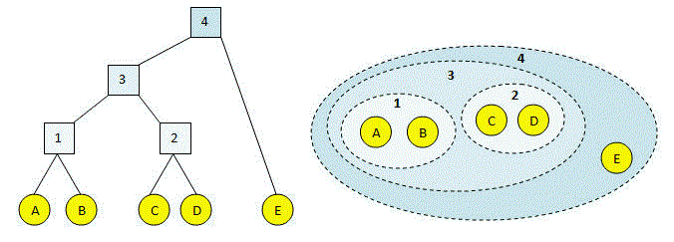
Agglomerative Clustering

Slide 13
Agglomerative Clustering
How to find closeness in clusters ?
Using Linkage / linkage distance
Types of Linkage
Single Linkage : take minimum of distance between any two points of two clusters
Complete (max) Linkage : take maximum of distance between any two points of two clusters
Average Linkage : Take average of distance between all points of two clusters
Ward Linkage : first new centroid after merging two clusters is calculated and then, sum of square of distance of each point from centroid in a cluster is found. Two clusters which will have minimum sum of squares will be chosen to be merged

Slide 14
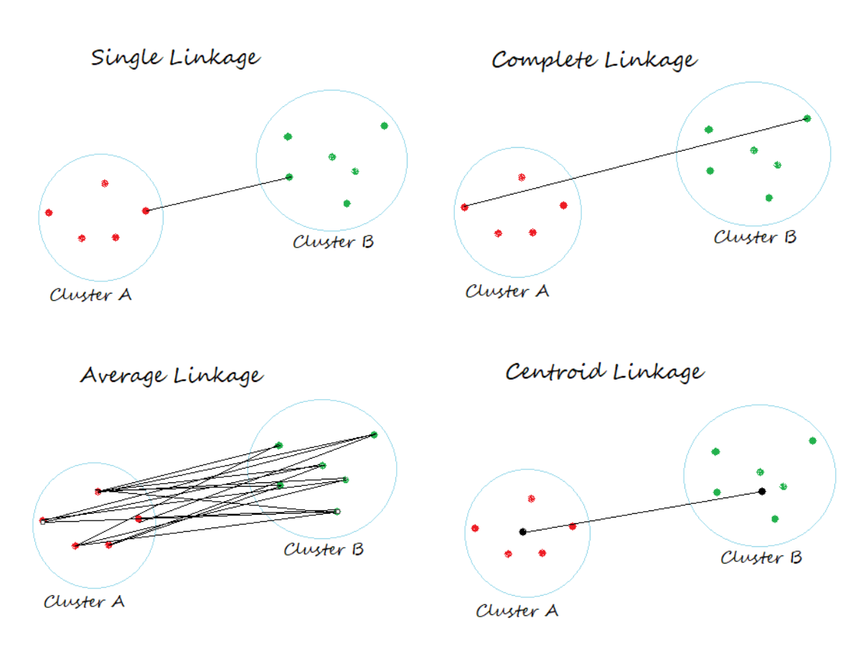
Agglomerative Clustering

Slide 15
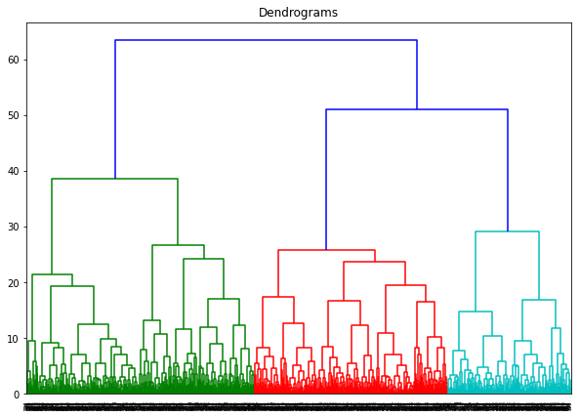
Agglomerative Clustering
How to find number of clusters
from dendrogram ?
In the dendrogram locate the largest
vertical difference between nodes
In the middle pass an horizontal line.
Count number of vertical lines intersecting
it is the optimal number of clusters

Slide 16
Extra

Slide 17
DBSCAN
Density-Based Spatial Clustering of Applications with Noise
Uses eps and min_samples to decide the density
Advantage :
Doesn’t require number of clusters at the beginning
Can cluster even complex shapes
Robust in detecting outliers
Disadvantage:
Can’t predict on new data
Requires standardized or scaled data for ease in fine tuning parameters
Slow and requires excessive memory
Tuning eps and min_samples requires expertise
Application:
Limitedly used for finding outliers / anomalies in existing data

Slide 18
DBSCAN algorithm
Step 1: First select a random point from data
Step 2: For selected point, Find all the points which have distance less than eps , these are called as neighbors. Count neighbors
Step 3: if count >= min_samples -> mark this point as core point
Step 4: else: check if there is any core point in neighbors any core point is there ? -> Yes then mark point as boundary point
Step 5: else: mark point as noise / outlier
Step 6: For boundary point assign same cluster number as core point in neighbor
For core point if already some point in neighbor having cluster number, assign the same cluster number, ELSE give new cluster number
Step 7: Select not visited point from neighbor (if present) else select random unvisited point and go to step 2

Slide 19
DBSCAN Working
Ref: https://towardsdatascience.com/the-5-clustering-algorithms-data-scientists-need-to-know-a36d136ef68

Slide 20
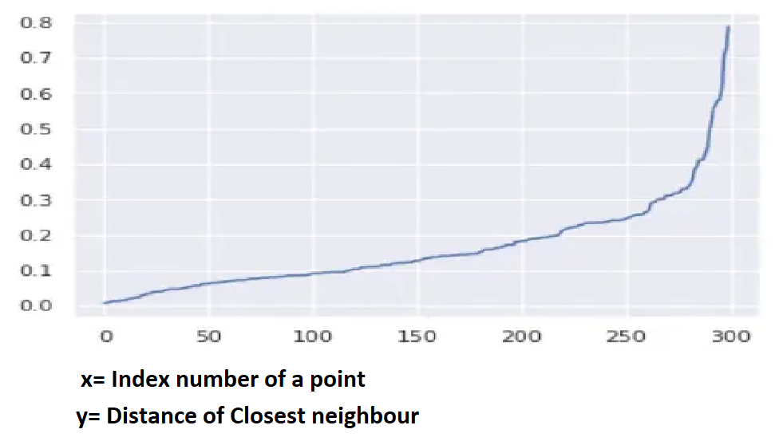
DBSCAN finding right eps
Knee method
Calculate distance of closest neighbor from every point ( using NearestNeighbours Algorithm)
Sort the values
Plot them
Find the Knee , where there is sharp change
It means after that distance value suddenly points start to become scattered
Link:
https://towardsdatascience.com/machine-learning-clustering-dbscan-determine-the-optimal-value-for-epsilon-eps-python-example-3100091cfbc

Slide 21
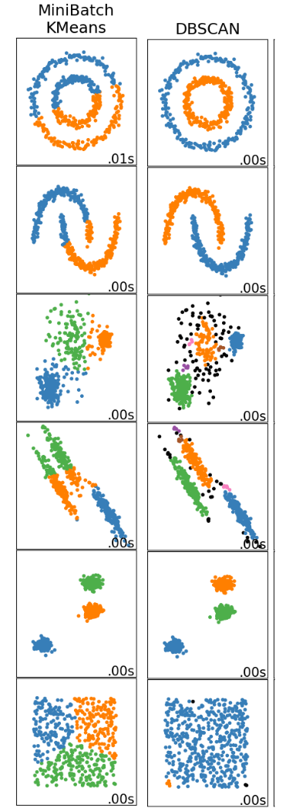

Data | K-means | DBSCAN
Complex w/o outliers
Complex w/o outliers
Simple with outliers
Complex with outliers
Simple w/o outliers
Scattered Data Single cluster
https://scikit-learn.org/stable/auto_examples/cluster/plot_cluster_comparison.html

Slide 22
Extra: K means++ : Choosing Initial points / Seeds
Assume there are n points in data
Select first centroid randomly from n points ( uniform distribution)
Calculate distance of all remaining points from all selected centroids. Take the distance from closest centroid as ‘d’
Select next centroid from remaining points based on probability ( probability = d^2) so, higher ‘d’ higher probability of point getting selected as centroid
Repeat step 3 & 4 till we select k centroids

